Slide 1
Database Management System Unit-I
Mrs. Kanchan M. Bhale
VPKBIET, Baramati
kanchan.bhale@vpkbiet.org

Slide 2
Outline
Data Models
Data Independence

Slide 3
Data Models
The first step in designing a database.
Process of creating a specific data model for determined problem domain.
Model is an abstraction of more complex real world object or event
It is communication tool. It can facilitate interaction among the designer, the application programmer and the end user.

Slide 4
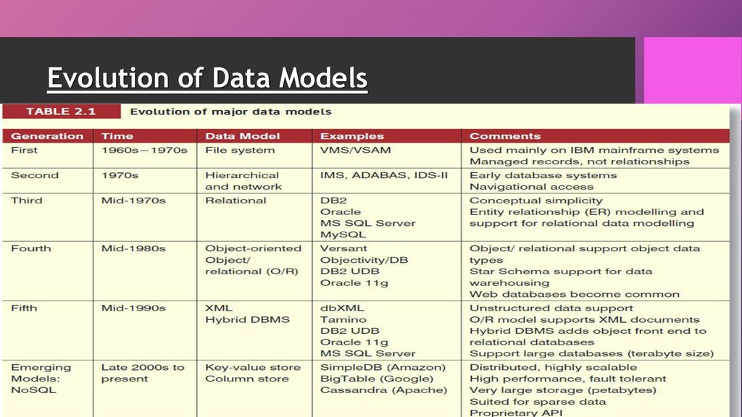

Slide 5
The Hierarchical Data Model
Hierarchical DBMSs became commercial available in the late 1960s with IBMs IMS and the DL/1-language.
The hierarchical DBMSs organise and model their data in a hierarchical fashion as a collection of trees.
Hierarchical databases support two types of information, the record type which is a record containing data, and parent-child relations (PCR) which defines a 1:N relationship between one parent record and N child-records.

Slide 6
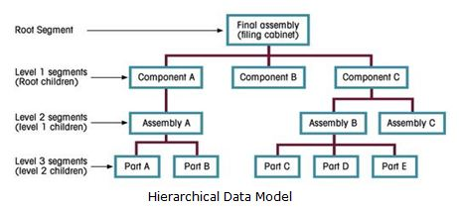
The Hierarchical Data Model

Slide 7
The Network Model
The network databases arrange its data as a directed graph and has a standard navigational language [DBTG]
The network databases offer an efficient access-path to its data and is capable to represent almost any informational structure containing simple types (e.g. integers, floats, strings and characters).
A set is a container of pointers identifying which sets of data can be reached from the current record. Three sets are defined by the CODASYL standard - singular/system sets, multimember sets and recursive sets.

Slide 8
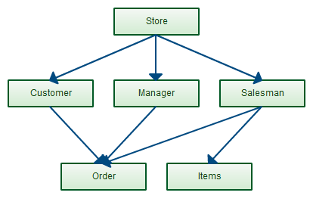
The Network Model

Slide 9
The Relational Model
The relational data-model was first represented by Edgar F. Codd in (Codd 1970)
All data is represented as simple tabular data structures (relations) which may be accessed using a high-level non-procedural language.
The physical implementation of the database is hidden, thus the programmer does not have to know the physical implementation to be able to access the data.
This makes the development of programs more effective and less dependent on changes in the physical representation of data

Slide 10
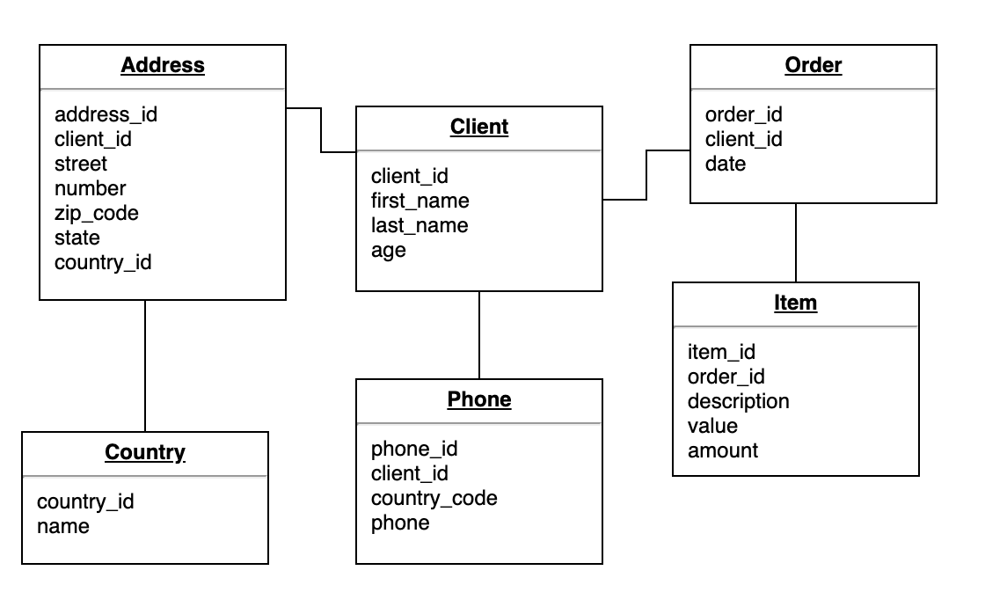
The Relational Model

Slide 11
The Entity Relationship Model
Entity–relationship modeling was developed for database and design by Peter Chen and published in a 1976 paper
Conceptual Model for Relational databases.
This model is used to define the data elements and relationship for a specified system.
ER model based on components : Entity, Attributes , Relationships.

Slide 12
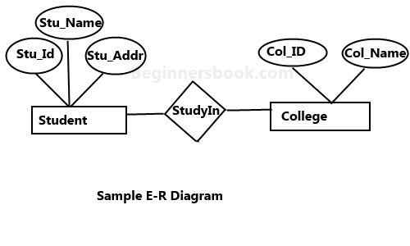
The Entity Relationship Model

Slide 13
The Object Oriented Model
The conceptual paradigm of the object-oriented DBMS (OODBMS) is quite different from the other approaches presented.
A core object-oriented data model consists of the following basic object-oriented concepts:
Objects and object identifier
Attributes and Methods
Class
Inheritance

Slide 14
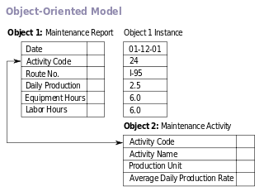

Slide 15
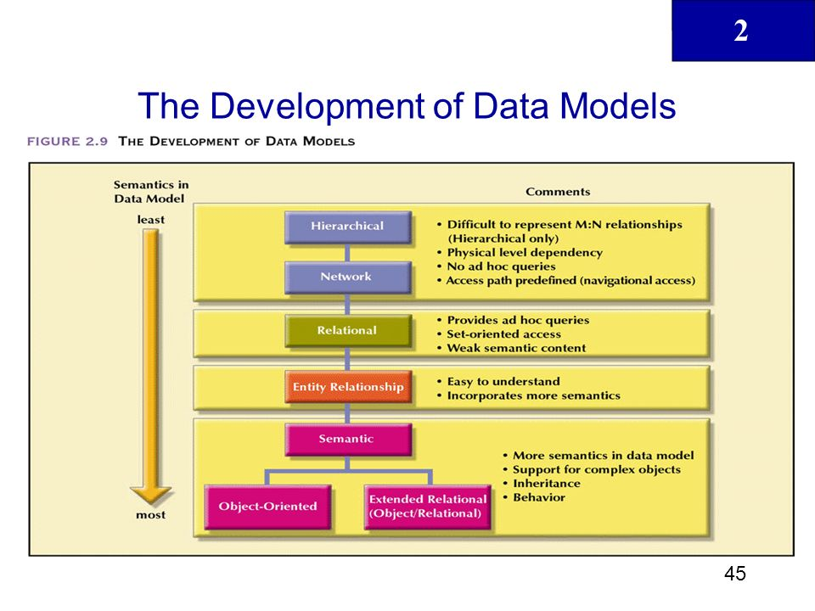

Slide 16
Data Independence
Data independence is ability to modify a schema definition in one level without affecting a schema definition in the next higher level.
There are two levels of data independence:
Physical Data Independence
Logical Data Independence

Slide 17
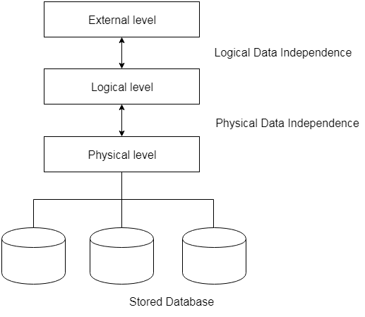
Data Independence

Slide 18
Physical Data Independence
Physical Data Independence – the ability to modify the physical schema without changing the logical schema
Applications depend on the logical schema
Modifications at the internal levels are occasionally necessary to improve performance. possible modifications at internal levels are change in file structures, compression techniques, hashing algorithms, storage devices, etc.

Slide 19
Logical Data Independence
Logical Data Independence is the ability to change the conceptual scheme without changing external view or programs.
For Example: Add/Modify/Delete a new attribute, entity or relationship is possible without a rewrite of existing application programs

Slide 20
Logical Data Independence
Physical Data Independence
Concerned with the structure or changing the data definition.
You need to make changes in the Application program if new fields are added or deleted from the database.
Modification at the logical levels is significant whenever the logical structures of the database are changed.
Concerned with conceptual schema
Example: Add/Modify/Delete a new attribute
concerned with the storage of the data.
A change in the physical level usually does not need change at the Application program
Modifications made at the internal levels may or may not be needed to improve the performance of the structure
Concerned with internal schema
Example: change in compression techniques, hashing algorithms, storage devices, etc

Slide 21
THANK YOU………….

